Slide 1
ATMOSPHERIC FIELD WORK(MET359)
WEST AFRICAN FORECAST FOR 6TH MARCH, 2022 AT 15OO UTC
FACULTY OF PHYSICAL AND COMPUTATIONAL SCIENCES
DEPARTMENT OF METEOROLOGY AND CLIMATE SCIENCE
KNUST, GHANA
NAME INDEX NUMBER
OTI JAMES ACHEAMFOUR ANTWI 9474919

Slide 2
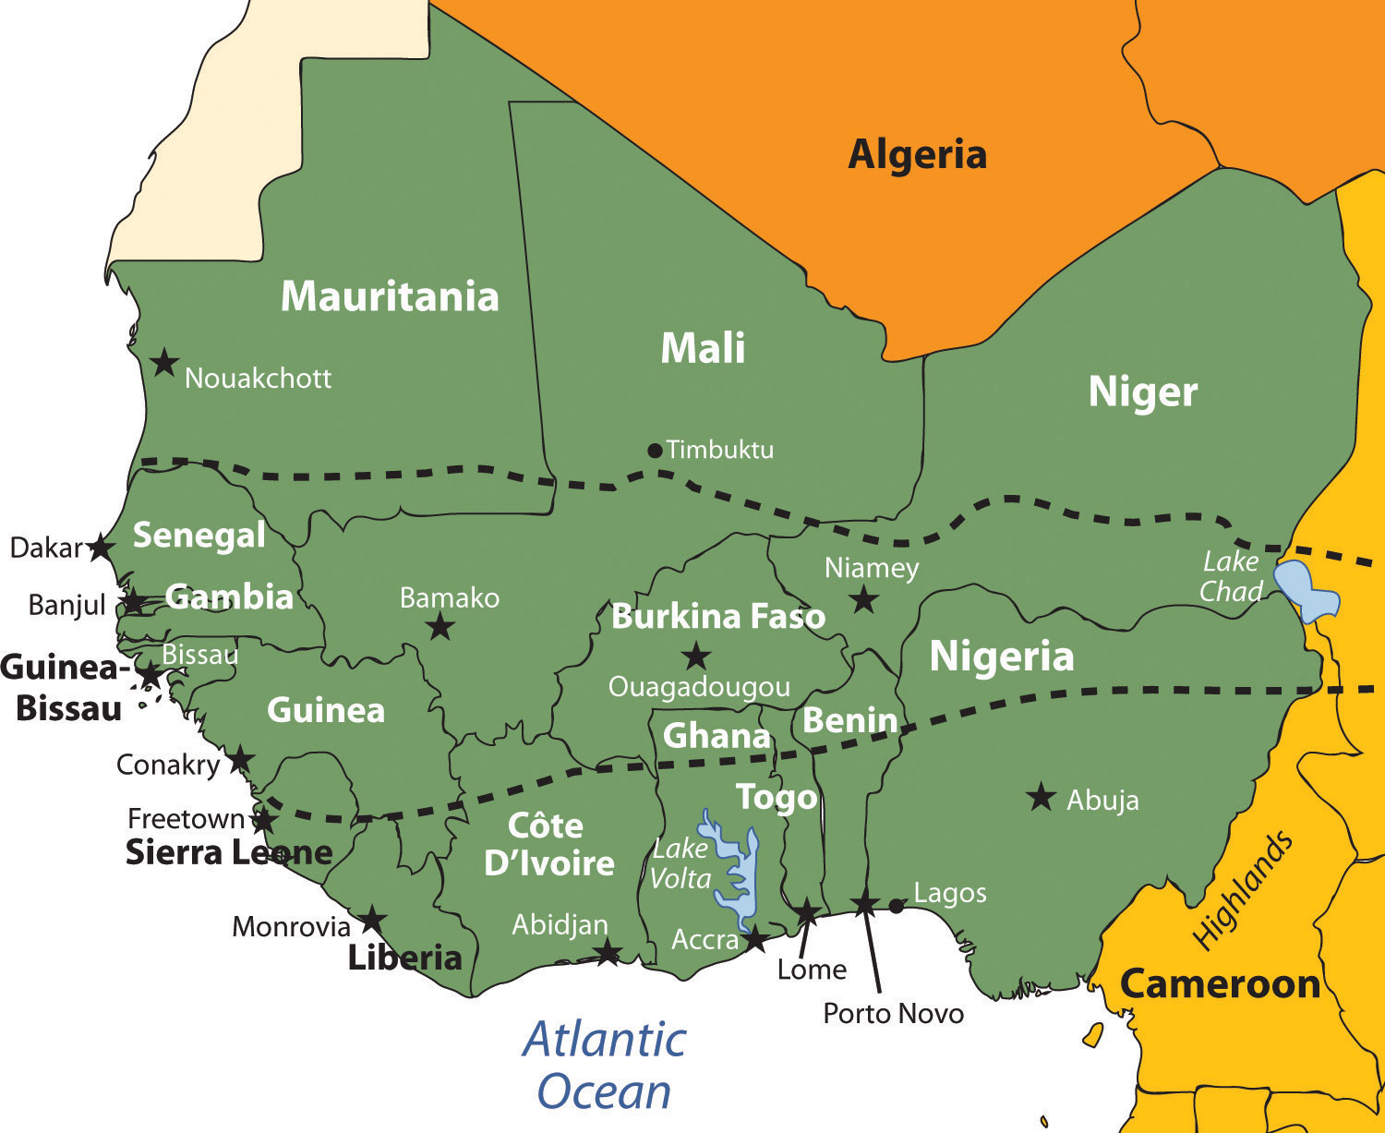
Some important components to note for this West African forecast include:
INTERTROPICAL DISCONTINUITY
HEAT LOW
AFRICAN EASTERLY JET
SUBTROPICAL JET
TROPICAL EASTERLY JET
INTERTROPICAL CONVERGENCE ZONE

Slide 3
INTERTROPICAL DISCONTINUITY: Its also known as the Intertropical front, is the separation zone between the dry Saharan air and the monsoon flow over West Africa.
HEAT LOW: Is an area of high surface temperatures and low surface pressures. Heat lows exist throughout the year and occur where insolation is high and evaporation is low.
AFRICAN EASTERLY JET (AEJ): The AEJ is a mid-tropospheric easterly wind maximum located between 700 and 600 hPa over Sahelian Africa during the northern hemispheric summer.
SUBTROPICAL JET: This jet, sometimes called the subtropical westerly jet, is a strong westerly wind over the Sahara desert between 200 and 300 hPa.
TROPICAL EASTERLY JET: is a strong easterly wind flow between 200 and 100 hPa that extends from the Tibetan mountains to Africa and generally exits over the Gulf of Guinea.
INTERTROPICAL CONVERGENCE ZONE: is the place where the tropical maritime and the continental air masses converge.

Slide 4
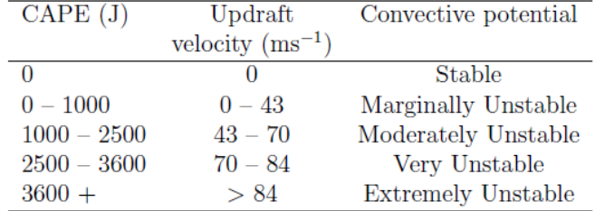
CONVECTIVE AVAILABLE POTENTIAL ENERGY(CAPE)

Slide 5
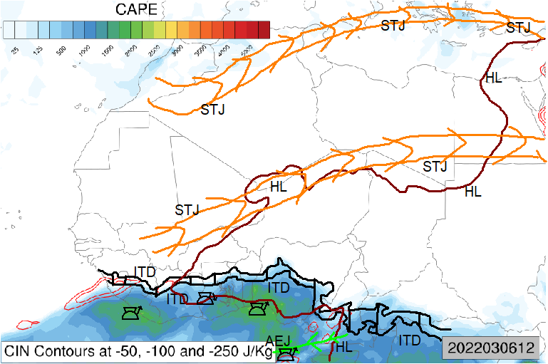
CAPE_CIN CHART FOR 1200 UTC

Slide 6
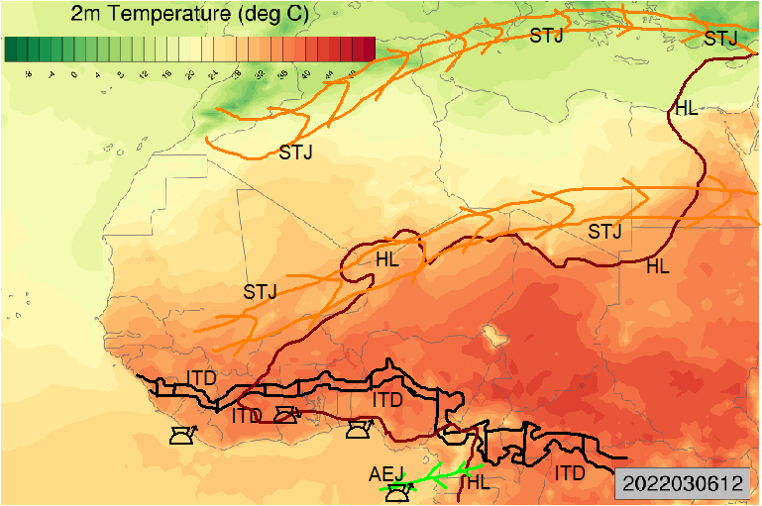
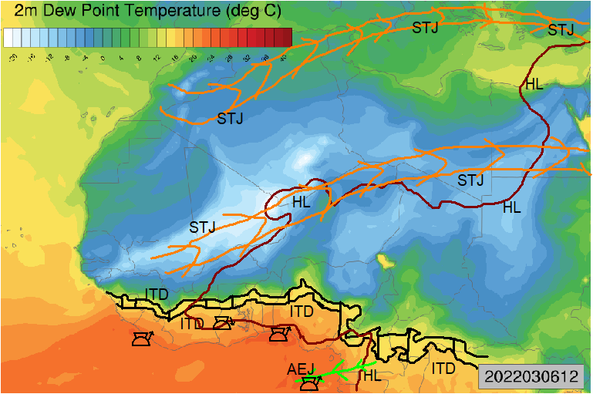
TEMP_2M CHART FOR 1200 UTC
DEWPOINT_2M CHART 1200 UTC

Slide 7
KEY
PARAMETER | COLOUR | SUMBOL | PROCEDURE
Intertropical Discontinuity (ITD) | Black |  | 15 ◦C Td
Heat Low (HL) | Brown |  | 1008Hpa
African Easterly Jet (AEJ) | Green |  | W(600Hpa)>15KT
Tropical Easterly Jet (TEJ) | Orange |  | W (200Hpa) ≥40KT (South of ITD)
Subtropical Jet (STJ) | Orange |  | W(200Hpa) ≥40KT (North of ITD)

Slide 8
Weather observation and forecast(1500 UTC)
From the image(CAPE_IN chart) generated at 1200 UTC, it can be observed that the heat low covers the western countries above intertropical discontinuity. The heat low will be high at 1500 UTC because the land would absorb a higher amount of the sun’s energy. Also by 1500 UTC, the insolation will be at its peak
Also it can be observed from the CAPE_IN chart that the range of the CAPE is high(1000J-2500J) around the southern part of Nigeria, Benin, Togo, Ghana, and Liberia. This implies that the environment will be moderately unstable, therefore resulting in convective activities in these parts of West Africa
It can also be noticed from the CAPE_IN chart that there is an African easterly jet in an unstable region on the Atlantic ocean below Nigeria, this means that the clouds formed at that location will be carried by the jet in the westward direction. It can be noted that the subtropical jet is strong in the southern part of Mali (Bamako) through to the northern part of Niger.
From the 2m dewpoint chart temperature chart, it can be observed that the southern part of Nigeria, Benin, Togo, Ghana, and Liberia have a high dewpoint temperature and a small dewpoint depression. This means that the air at 2m level will be moist in the countries mentioned above
Countries such as Niger, Mali, Mauritania, Burkina Faso, Senegal, Guinea, and Guinea Bissau have a very low dewpoint temperature and a very large dewpoint depression as observed from the 2m dewpoint chart. This implies that the air at 2m level in the mentioned countries will be very dry
It is also observed from the 2m temperature chart, that there is a high temperature in the southern and middle parts of West Africa. This will result in a warm environment in the West African countries

Slide 9
From the observations, at 1500 UTC, there will be extremely warm temperatures and warm, dry stable air in the Sahel regions, middle and northern part of West Africa with Niamey in Niger and the northern part of Benin recording the highest temperature.
Also there will be chances of heavy rains with warm conditions in Porto Novo, Lome, and Accra which are in Benin, Togo, and Ghana respectively. The southeastern region of Ghana is likely to receive heavy rains as well.

Slide 10
REFERENCE
A.H. and Cassano J.J. (2006), Applied atmospheric dynamics, John Wiley and Sons, Ltd.
https://github.com/jeffjay88/MET361-TROPICAL_METEOROLOGY_LECTURE_SERIES
https://en.wikipedia.org/wiki/Dew_point
https://en.wikipedia.org/wiki/Dew_point_depression

